Slide 1
Advance Computer Graphic Final Demo
Chih-Hung, Liu

Slide 2
Outline
Introduction
Metro Map Layout
Example Result
Conclusion
Future Work
Reference

Slide 3
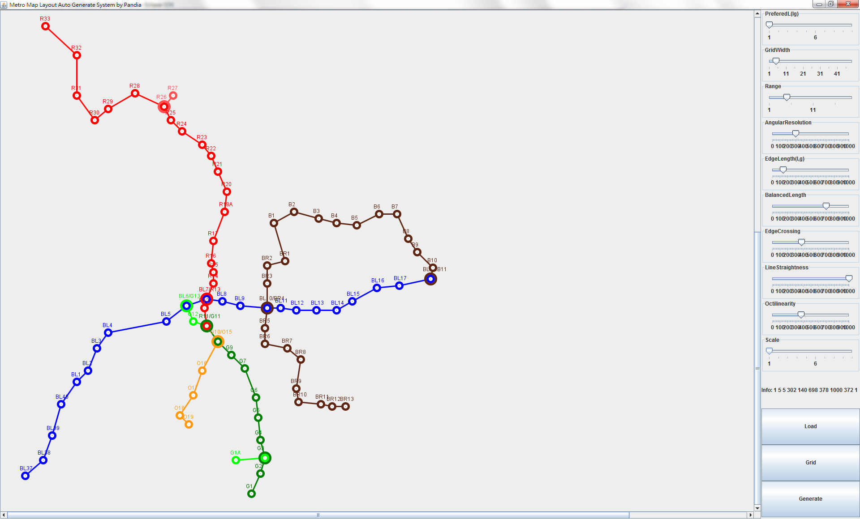
Interface

Slide 4
Introduction
We can adjust the parameter and scale picture from the right side.

Slide 5
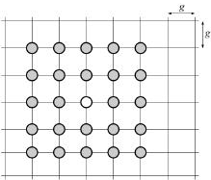
Metro Map Layout
The graph is embedded on an integer square grid. The spacing between adjacent grid is “g”

Slide 6
Metro Map Layout
Multi-Criteria Optimization
They have five criteria, c1 to c5 which is use to measure the quality of the generated maps.
Each criterion ci is weighted with wi

Slide 7
Metro Map Layout
Edge Crossings
The sum of the number of edges that cross.
Planar map has no such edges.
Unintentional edge crossings can affect the readability of the map.

Slide 8
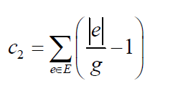
Metro Map Layout
Edge Length
A common feature of metro maps is that stations should be spaced evenly along lines and the spacing should be consistent across the entire map.
Ideally spacing is one grid spacing.
Don’t need to worry |e| < g
Diagonal edges is penalized. => Prefer vertical and horizontal edges.

Slide 9
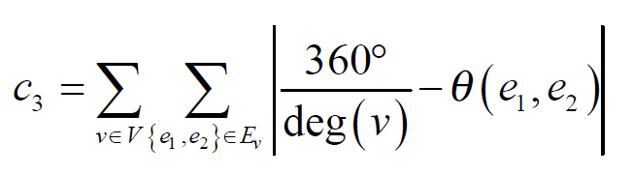
Metro Map Layout
Angular Resolution
Sometimes, many lines pass through a single node.
There is only a small angle between two edges is hard to distinguish.
Abs is used so that edges too close together get penalized as much as far apart.

Slide 10
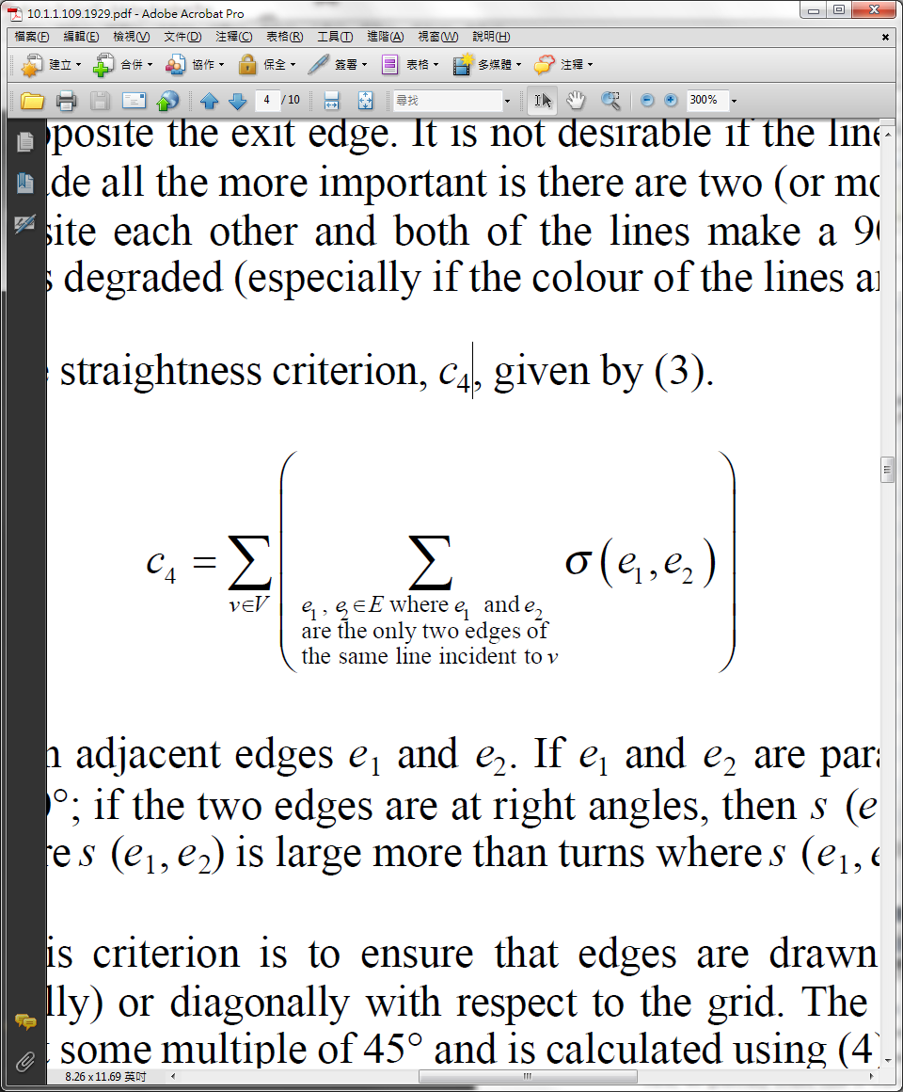
Metro Map Layout
Line Straightness
It is not desirable if the line turns sharply
is the angle between e1 and e2.
If e1 and e2 are parallel then it is 0.

Slide 11
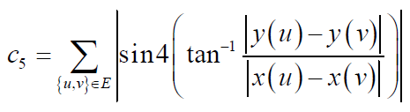
Metro Map Layout
Four-gonality
Assure that edges are drawn at multiple of 45 degree.
45, 90, 135, 180, 225, 270, 315 are prefered.

Slide 12
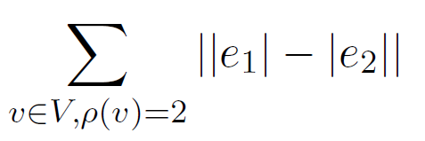
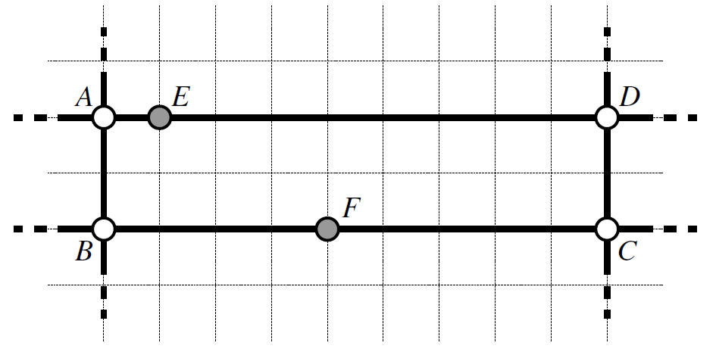
Metro Map Layout
Balanced Length
Try to ensure the edge lengths are approximately equal.

Slide 13
Metro Map Layout
Total Weighted Criteria
T = w1c1 + w2c2 + w3c3 + w4c4 + w5c5 + w6c6

Slide 14
Metro Map Layout
Node Movement
Given a maximum radius r which is a multiple of g.
Larger r might alter the map so that it differs to reality.

Slide 15
Metro Map Layout
Cooling process is used whereby r is reduced to 1 by the last iteration.
They use linear cooling schedule (Log, or other schedule is ok, too.)

Slide 16
Metro Map Layout
The initial value t: t0 is calculate.
Each grid intersection up to r intersections from node is tested by moving the node and calculate t.
A set of locations is remembered where t < t0, and the node is move to the smallest t.

Slide 17
Metro Map Layout
Locations cause another node or edge become occluded are not considered.
Thus crossing will not happen during movement.

Slide 18
Metro Data
Only currently running Metro Station in Taipei’s position can be found in Google Map. (Longitude and Latitude)
Manually scale the coordinate and connect the line with nodes.
Time consuming => Only one real world test data.

Slide 19
Result
There are some bugs when moving nodes.
I think the scoring function is fine (maybe)
The constrain of moving nodes is a little buggy.

Slide 20
Demo

Slide 21
Future Work
Resolve the Intersection’s color problem.
The color shall at the same position.
Red and Green lines here ->

Slide 22
Reference
Jonathan M.Stott, Automatic Layout of Metro Maps Using Multi-criteria Optimization. ( http://www.jstott.me.uk/thesis/thesis-final.pdf )

